Slide 1
Notes 3D App
Project Phase 3 - IMPLEMENTATION, By Tom SchmÄling
https://github.com/LeftEmpty/project_Notes3D

Slide 2
Table of Contents
Application Introduction and Purpose
System Architecture
Application Features
Screenshots
Used Technologies
Changes made to Concept
Project Tour (Video)

Slide 3
Application Introduction and Purpose
The main goal of the application to make it easier for 3D Artists, Game Studios, etc. to check what models they have on their system as well as take notes and communicate feedback on them in, for example, a remote setting.
The application provides easy viewability of 3D models by letting the user upload multiple models and displaying them directly in the browser.
Uploaded 3D models are saved to a user account which provides taking notes, contact lists, and viewing other users’ uploaded models.

Slide 4
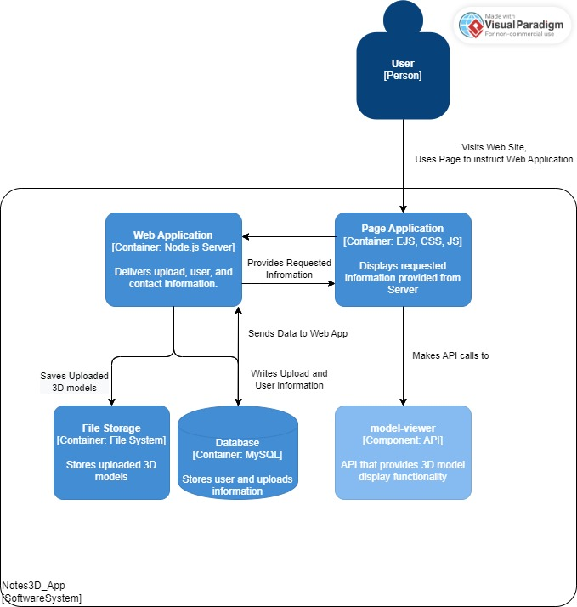
System Architecture
The Structure has changed slightly since the Conception Phase.
The main server is written in node.js and uses various packages for features such as user authentication, files uploading, etc.
Uploaded 3D models are saved on the Server, while information about the file is saved to the database.
A link of the file is provided to the <model-viewer> API element on the Uploads page to display them to the end-user.
For a production environment, the storing of uploaded files should utilize a cloud storage provider.

Slide 5
Application Features
The Application features include:
Users, registering and logging in of users, includes input checking, sessions, password hashing, etc.
Uploading ‘.glb’ 3D model files, the files are saved on the server while information such as filename, creation date, file size, etc. are saved to the MySQL database (the files can be deleted as well)
Creating and editing Notes, uploads on the database include note data which can be created on upload or edited later via the uploads page.
Contacts, a user can add and remove users from their contacts list. You can view the profile and uploads of other users easily this way.
The design also supports media queries and is therefore readable on any device.
The application could still use some work in terms of UX and Design.

Slide 6
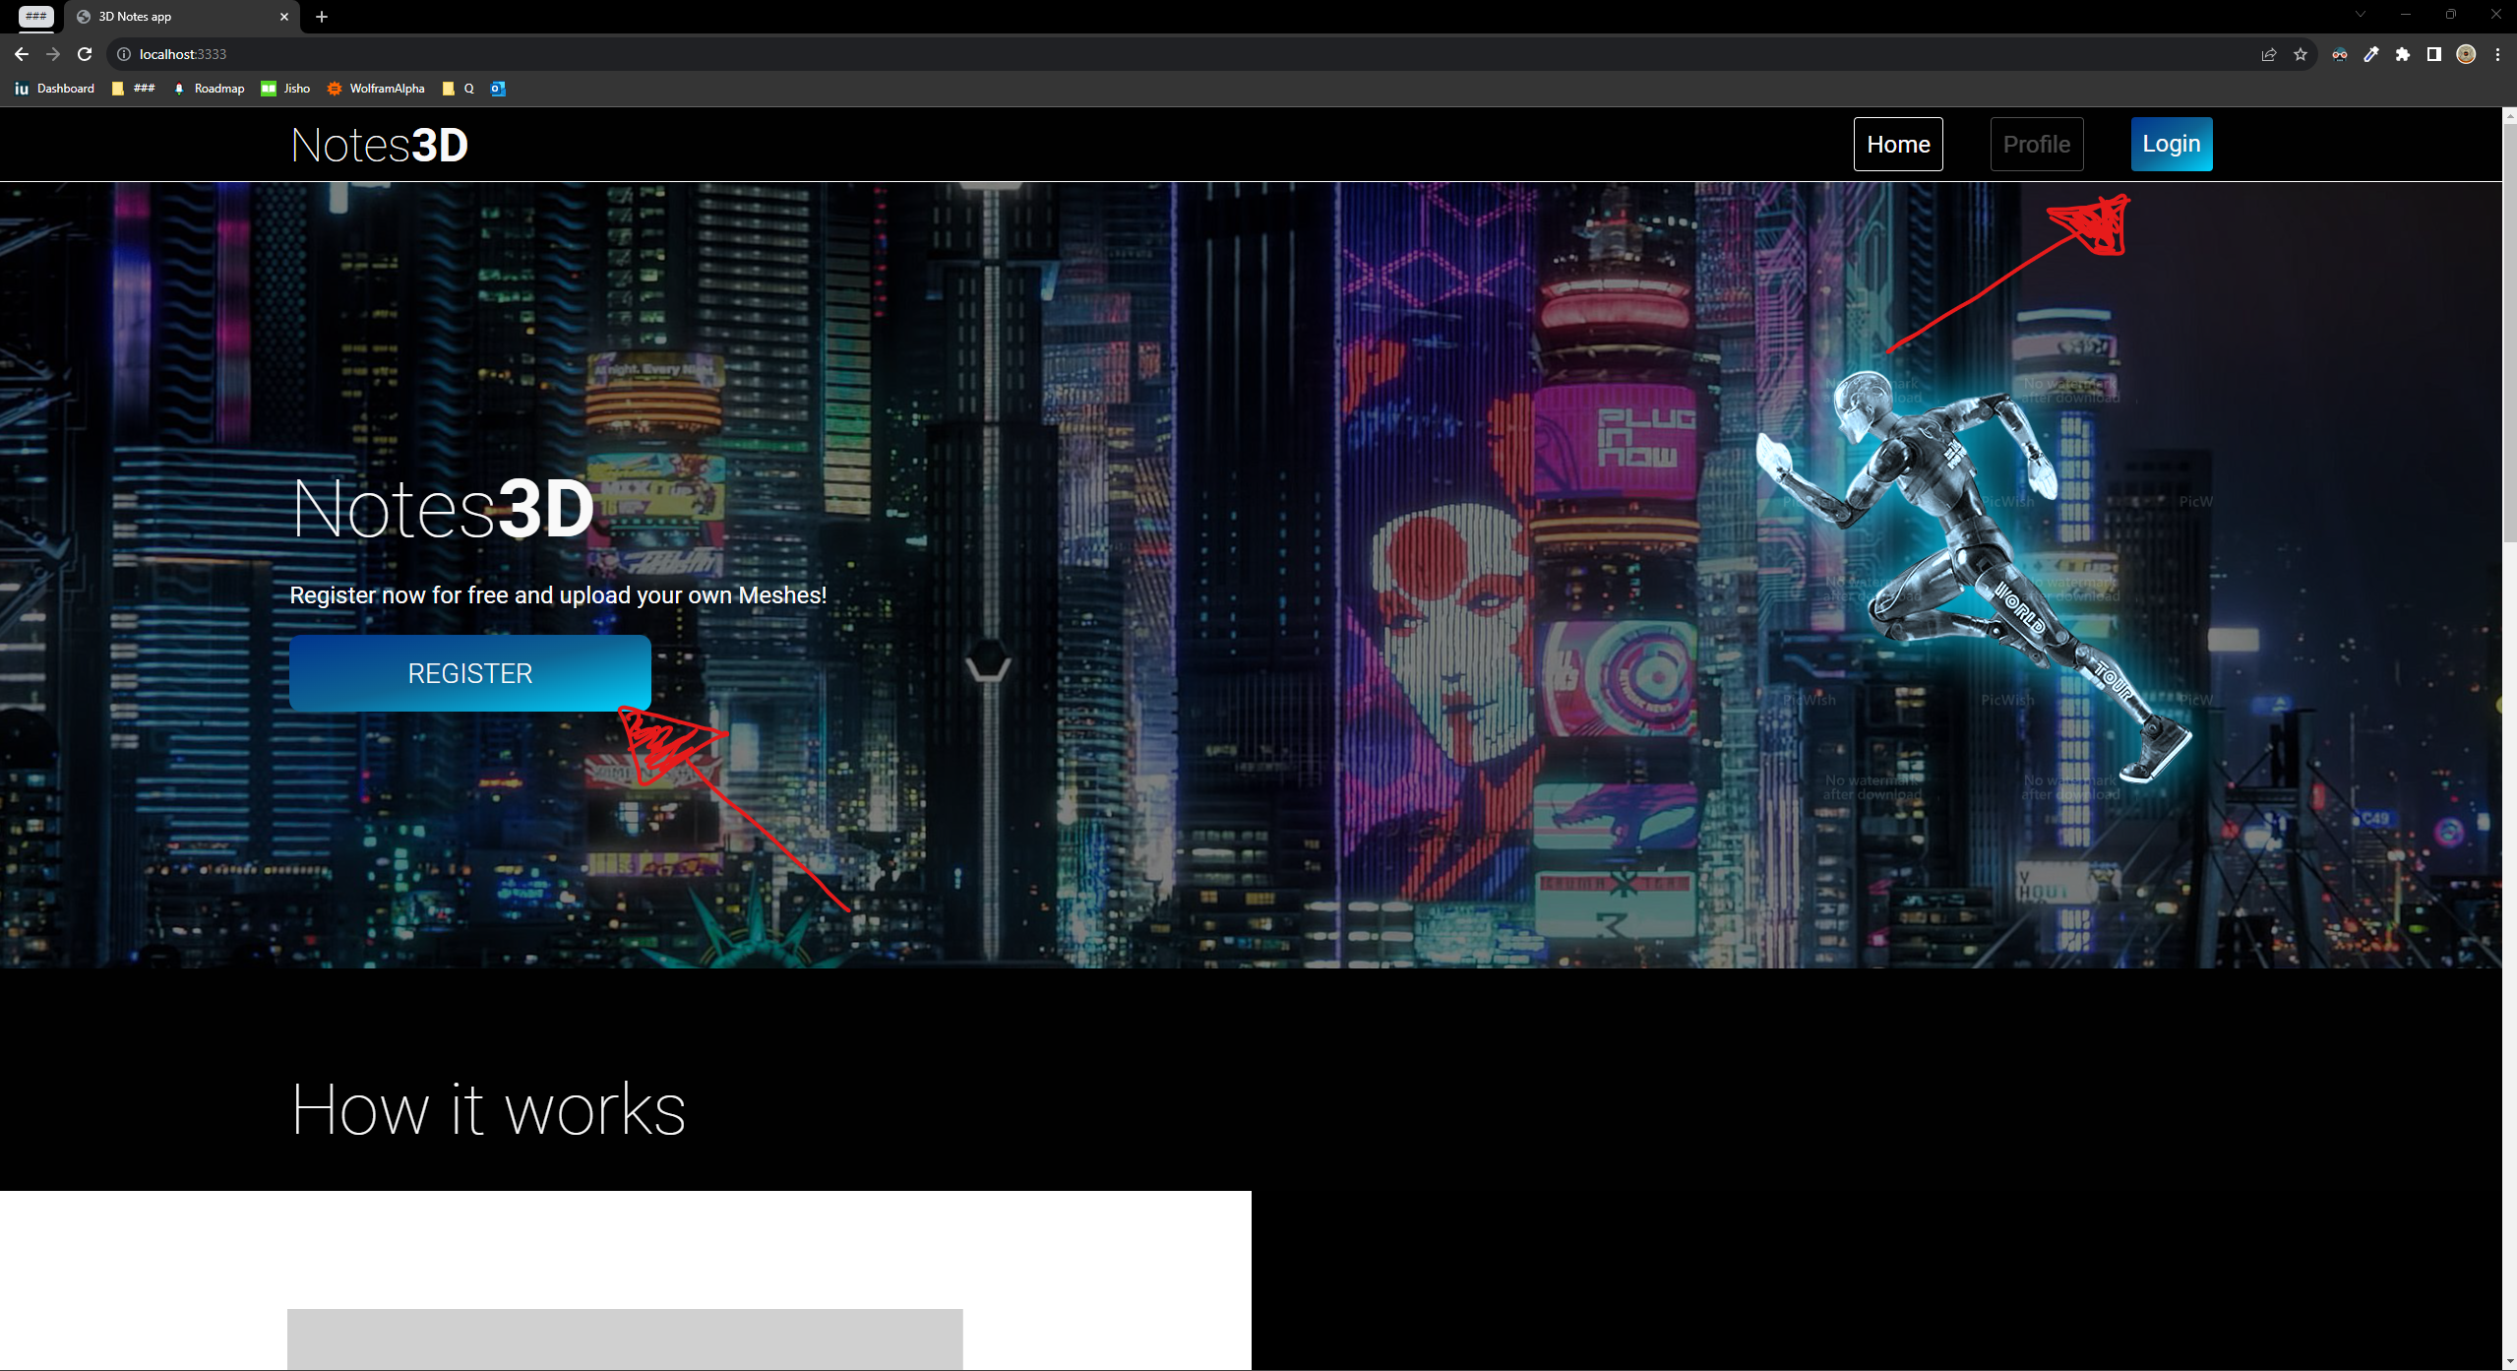
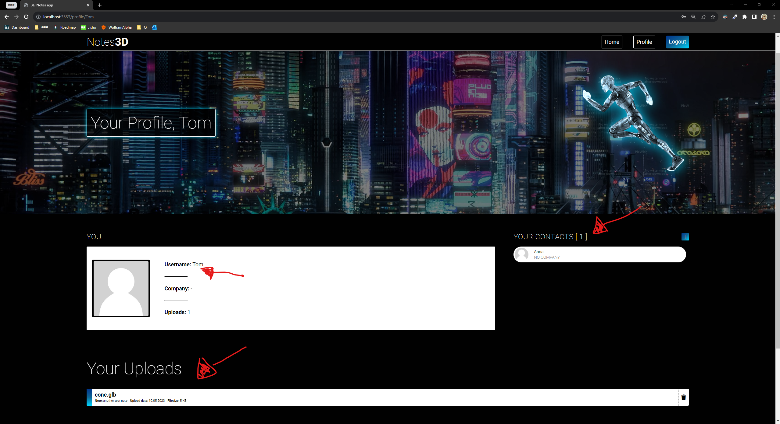
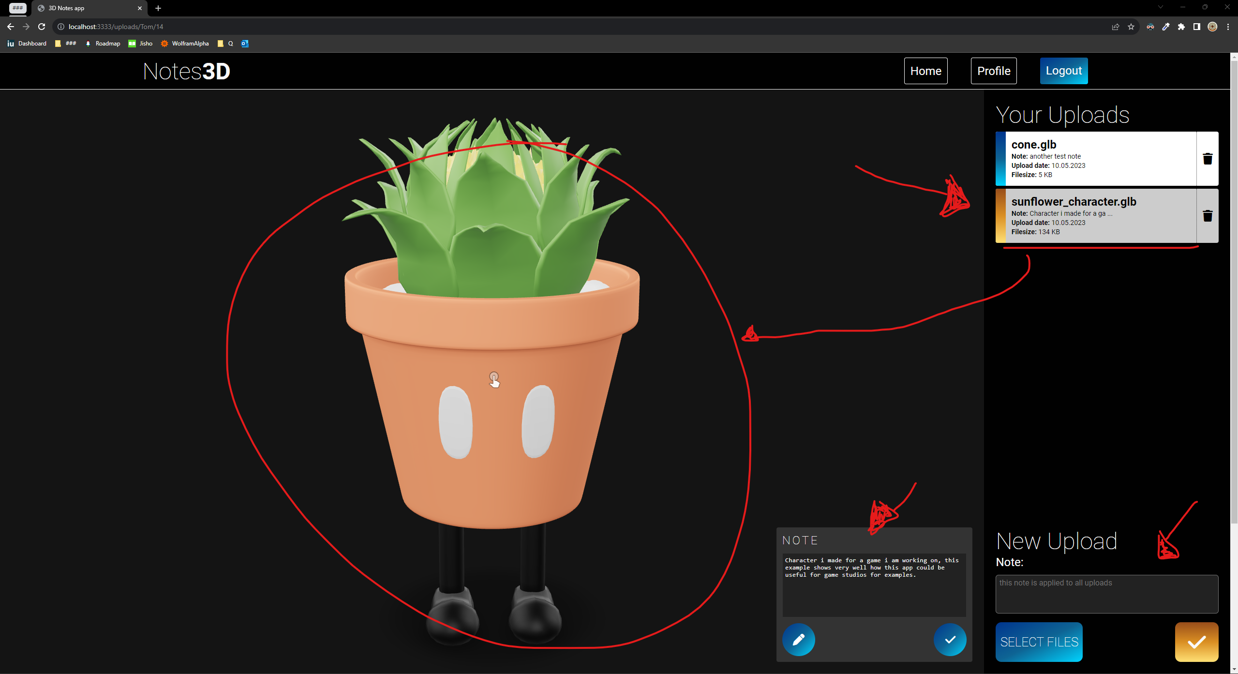
Screenshots
Home (Index)
Profile
Uploads
The content on the Home page explains / introduces the page. Users can register or login via popup.
Any other pages need the User to be Authenticated.
The Profile page shows user information and uploads.
The contact list displayed here always belongs to the currently logged in user.
The URL is made up of /uploads/:username/:uploadid
This page is used to upload or delete models and edit notes.
*Key features are marked with red Arrows. Please view the video on the last slide for a walkthrough of these pages.

Slide 7
Used Technologies
The mainframe of the Project uses Node.js with express, supported by a MySQL database
I have decided to stay very lean with the project and try not to use too many frameworks, the front end of the page is written in plane HTML (EJS), CSS and JS.
Used Node.js packages:
Express (including express session), multer, bcrypt, passport
The <model-viewer> API from google is used to display the 3D models via custom HTML element.
Used technologies are also listed on the GitHub repository.

Slide 8
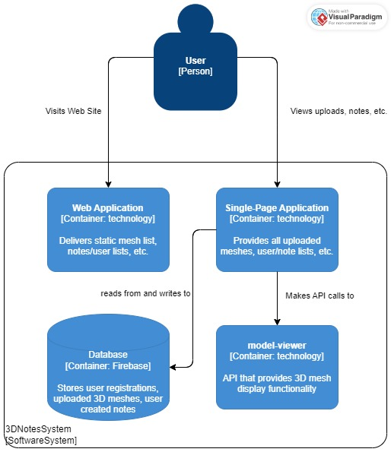
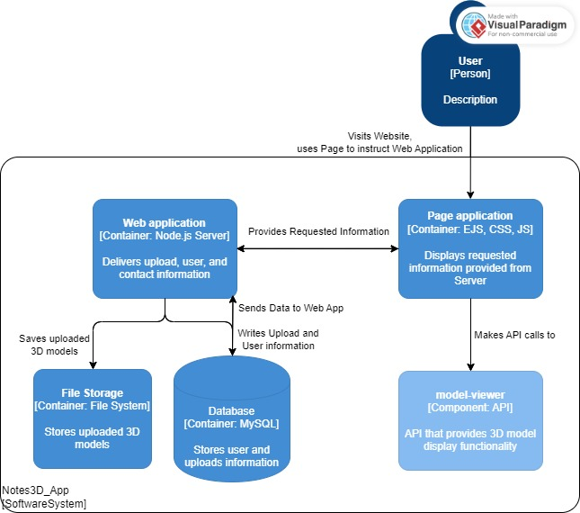
Changes made to Concept
There were minor changes made to the overall structure of the system, including:
A file storage location which wasn’t accounted for in the conception phase
The usage of technologies wasn’t decided on during the conception phase, after multiple prototypes using Javalin, Node.js, and other frameworks. I decided on Node.js because of its simplicity and amount of available documentation
Removed Features
I have, for now, removed the feature of implemented Notes directly on to the model in 3D space as the Project rapidly grew in scope.
Please let me know if the scope of the project is acceptable as is or if you would like me to implement this feature as well.
Concept
Implementation

Slide 9

Project Tour

Slide 10
Thank you!
The Project setup is explained on the GitHub repository in detail. I am always happy to answer any questions regarding the project.
Please message me on Teams if you have any questions. Thank you for your Attention.

